Slide 1

Historical Summer Olympic Analysis
By:
Julian Kim, Brandon Hayes, Fei Meng, and Rosa Munoz

Slide 2
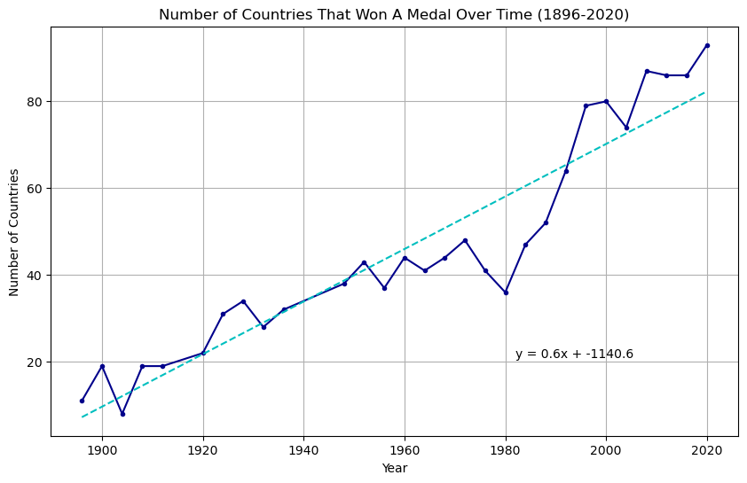
How has the addition of new countries affected the Olympics?
Number of countries that won at least one medal
No datapoint for 1940 and 1944
77 countries medaled in 2024 Summer Olympics¹
Predicts 84 countries to win a medal
1 - https://olympics.com/en/paris-2024/medals

Slide 3
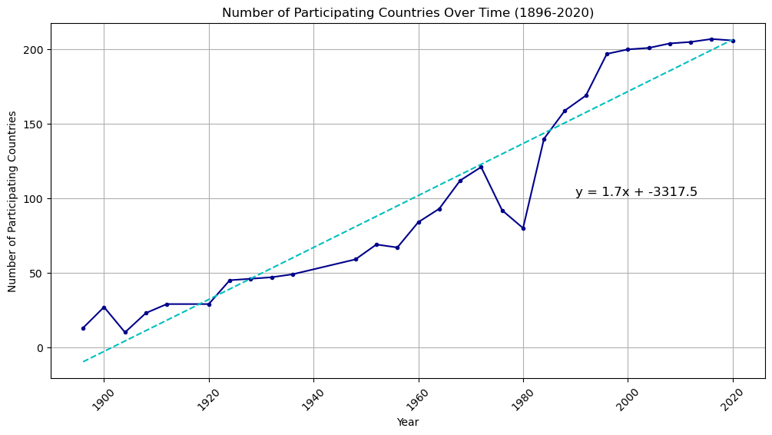
How has the addition of new countries affected the Olympics?
Number of countries participating
206 countries participated in 2024 Summer Olympics¹
Predicts 214 countries
1 - https://olympics.com/ioc/faq/competing-and-being-part-of-the-games/how-many-athletes-and-countries-take-part-in-the-olympic-games

Slide 4
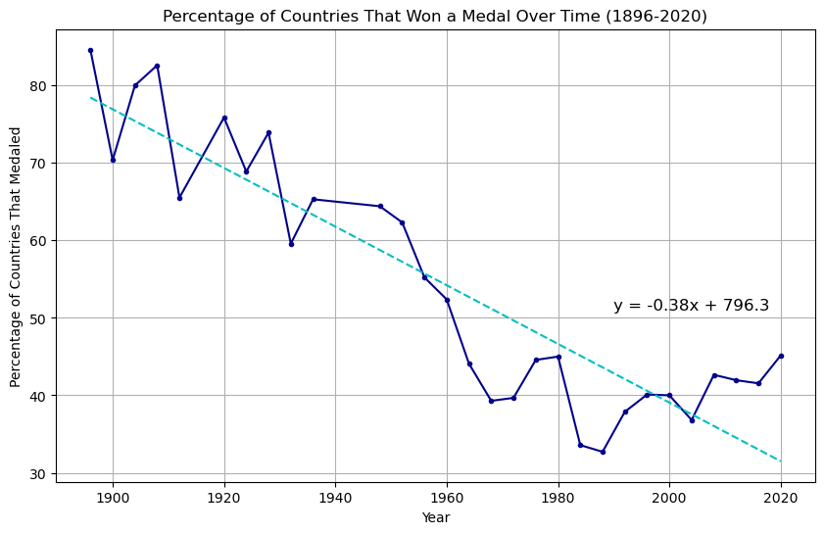
How has the addition of new countries affected the Olympics?
Dividing number of countries that won a medal by number of participating countries
38% of countries won a medal in 2024 Summer Olympics
Predicts 27% of countries

Slide 5
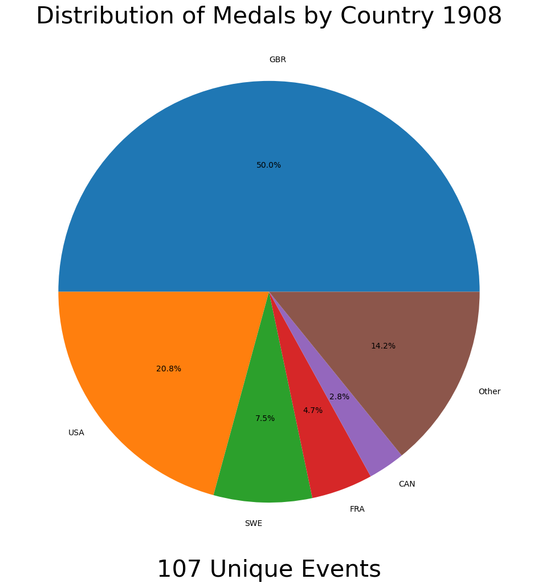
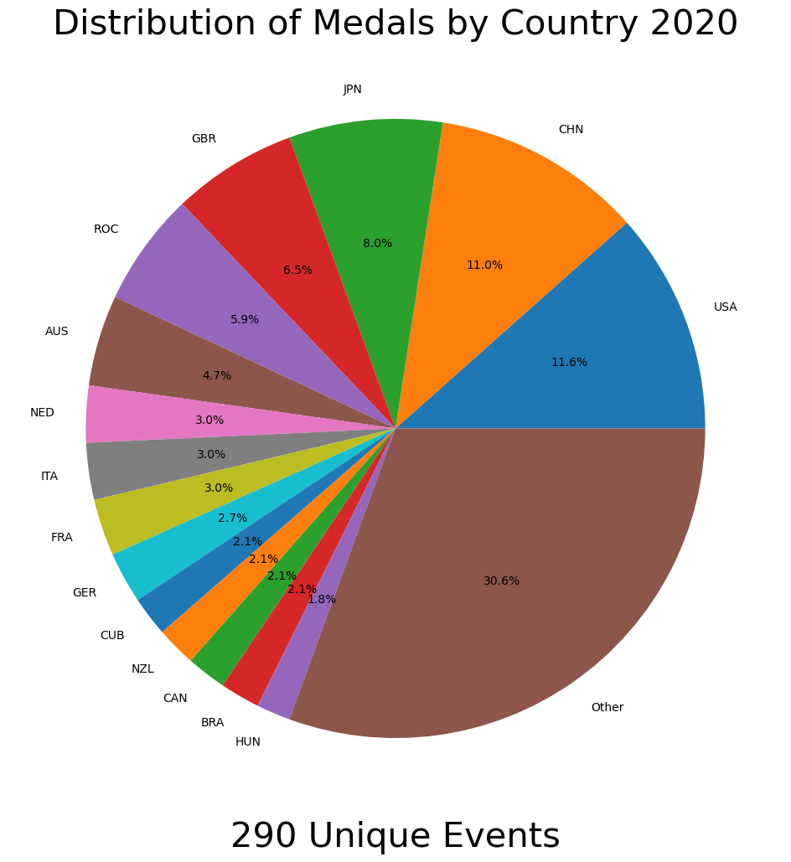
How has the addition of new events affected the Olympics?

Slide 6
How has the addition of new events affected the Olympics? (part 2)

Slide 7
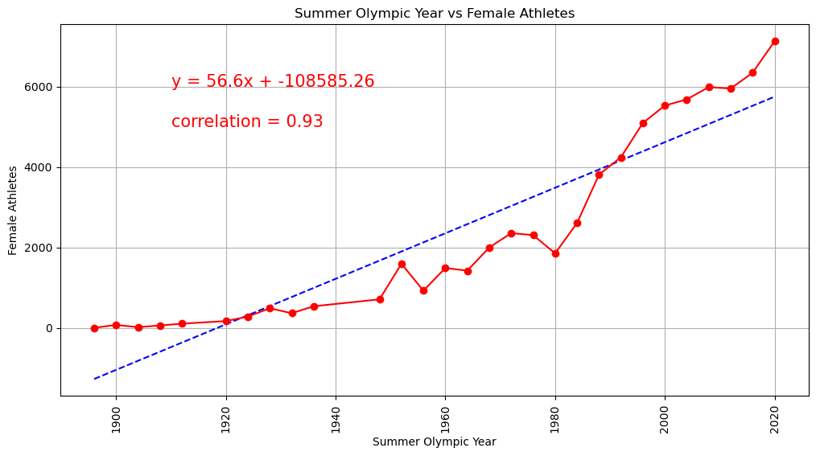
Have there been more female athletes added over time?

Slide 8
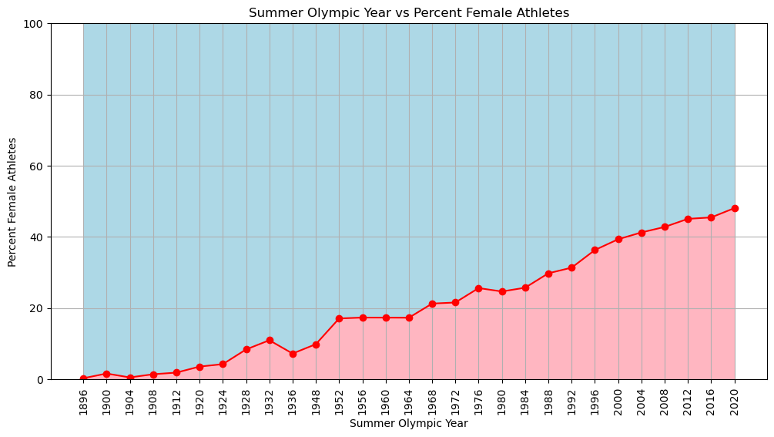
Have there been more female athletes added over time? (Part 2)

Slide 9
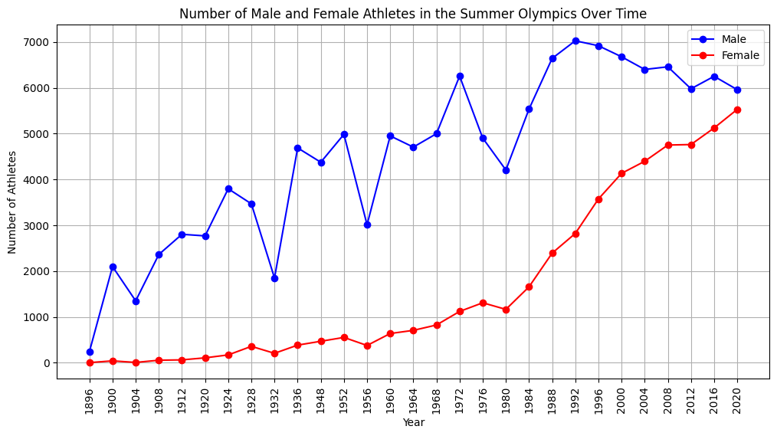
Have there been more female athletes added over time? (Part 3)

Slide 10

References
https://www.kaggle.com/datasets/muhammadehsan000/olympic-historical-dataset-1896-2020?select=Olympic_Athlete_Bio.csv
Olympic_Athlete_Bio.csv
Olympic_Athlete_Event_Results.csv
Olympic_Games_Medal_Tally.csv
Olympic_Results.csv
Olympics_Country.csv
Olympics_Games.csv

